Slide 1
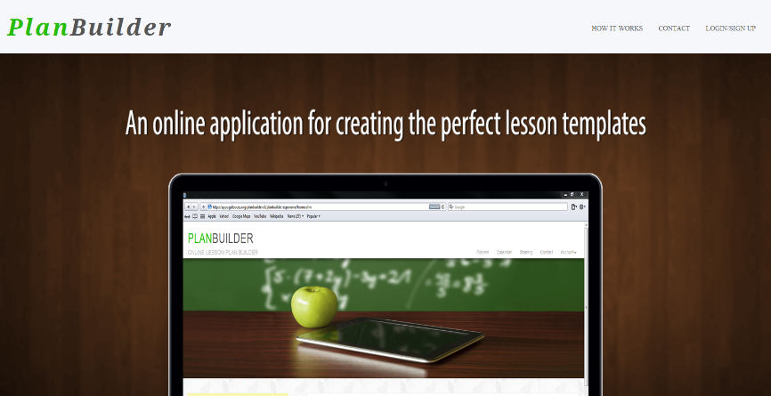
PlanBuilder How-To

Slide 2
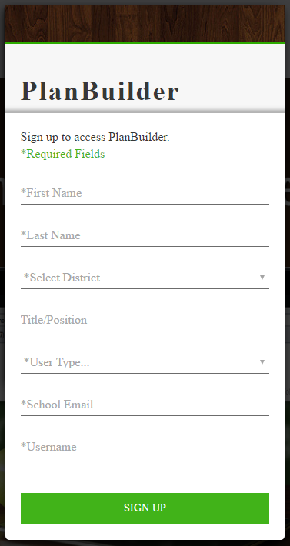
Login/Sign Up
Click “LOGIN/SIGN UP”.
If you already have an account type in your username(first part of email before the “@”) and password.
If not click “New User?”
Fill in all required fields for creating a user(marked with an *).
Depending on what district is selected you may be required to provide a password.
If you are note required to provide a password, your password is the same as your network password(the password you use to login to your computer).
Use your school email not personal email. Your username is created from your email.

Slide 3
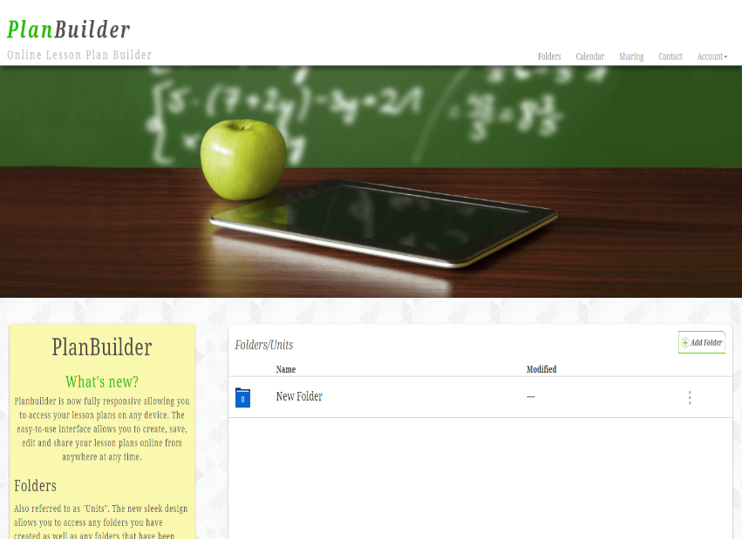
Folders Page
After successfully logging in you will see the navigation bar(Folders/Calendar/Sharing/Contact/Account).
On the left of the page there is a sticky note that highlights some of the features of PlanBuilder.
If you are a new user the right side will be empty. This is where your folders/units will be displayed. Click “Add Folder” to create a new folder. A modal will appear that will allow you to give the folder a name and select the color of the folder.

Slide 4
Folders Cont.
The number inside the folder displays the number of lessons that folder contains.
The “Modified” column updates any time a lesson is created/updated.
The displays the options for the folder.
Click the options to edit the name of the folder or delete the folder.
***Deleting the folder will delete any lessons inside the folder.
Click anywhere in the folder row to load its lessons.

Slide 5

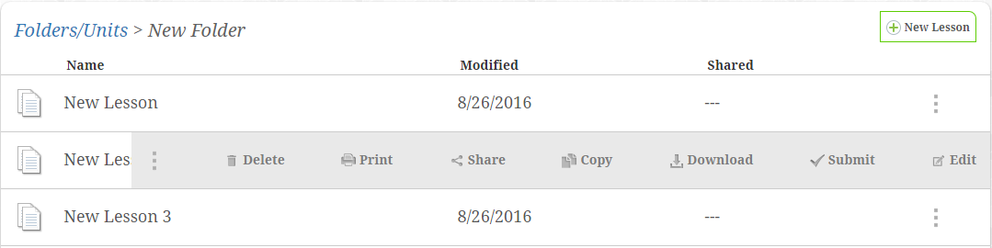
Lessons Page
To create a lesson click the new lesson button . .
You will be prompt to name the lesson and select the template you would like to use for your lesson.
Once you have created lessons they will appear on the lesson page. Click the lesson to load/view/edit the lesson.
Click the button to display the options for the lesson.

Slide 6
Lessons Options
Delete – Deletes the lesson. (Nothing is really ever deleted, but instead it is still in the database just hidden from view).
Print – Creates a print friendly version of the lesson.
Share – You can share the lesson with all PlanBuilder members(community share), or choose to share the lesson with specific users(direct share). Directly sharing the lesson with other member(s) gives them permission to make edits to the lesson.
Copy – Creates a duplicate of the lesson.
Download – Creates a PDF of the lesson that you can save to your computer.
Submit – Submits the lesson to your administrator to allow them to review the lesson.
Edit – Allows you to change the name of the lesson.

Slide 7
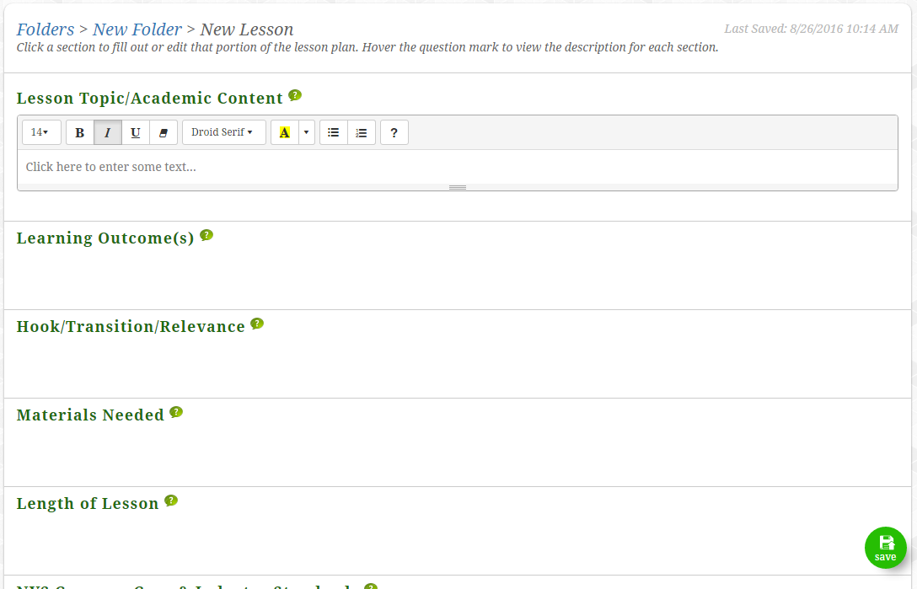
Lesson Template
After creating a lesson the template is generated.
Each section has a title and . Hover over the question mark to preview the description for that section.
Click the white space below a section to load the text editor and begin inserting content.

Slide 8
Template Cont.
At the top of the template you can see the save history.
The last section of each lesson allows users to upload any documents or add any url’s that relate to the lesson.
There are multiple ways to save a lesson.
Each time a new section is clicked the lesson saves.
Users can click the green save button in the bottom right corner of the page
Autosave occurs after 1 minute of inactivity.

Slide 9
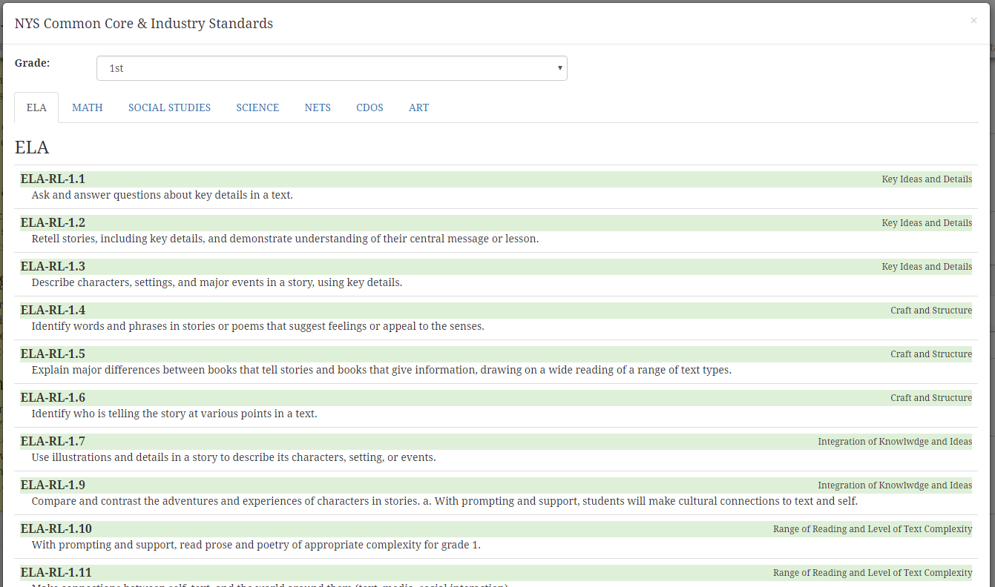

Standards
Click the standards section to load the standards button and text editor.
You can type in standards or add them by clicking the .
Select a grade and standard type to load the standards.
Click a standard and it will be added to your lesson template.

Slide 10
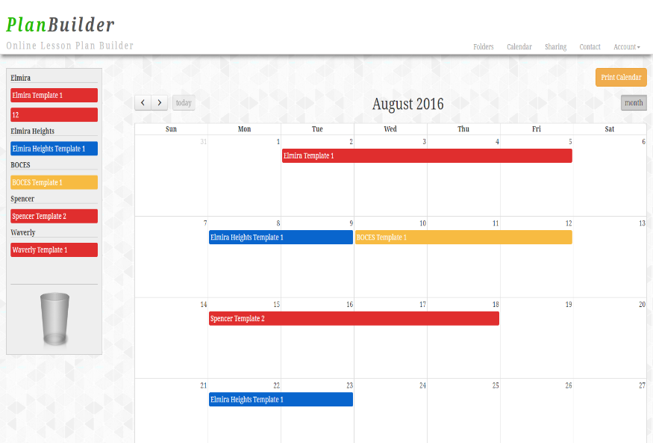

Calendar Page
Once lessons are created they can be scheduled in the calendar.
Drag and drop a lesson from the left side of the screen onto the calendar.
If a lesson is multiple days you can click and drag the edge of the lesson to cover the amount of days required.
If you need to reschedule a lesson click and drag it to the new day.
Drag a lesson to the trash can on the left to remove a lesson from the calendar.
There is a button at the top of the page that will create a printable version of the calendar

Slide 11
Sharing Page
In the left hand box labeled “Community Share” you can see any lessons that others PlanBuilder members have shared.
Click the to show the options for their lesson.
You can view/print/message author of these lessons.
In the right side box labeled “Direct Share” will list and lessons that have been directly shared with you for collaboration.
This lists the title/author/updated date/and amount shared with.
Only one user can update a lesson at a time. If a user has the lesson open it will appear locked to all other users.
Click a lesson to load its content and begin leaving comments or editing the lesson.

Slide 12
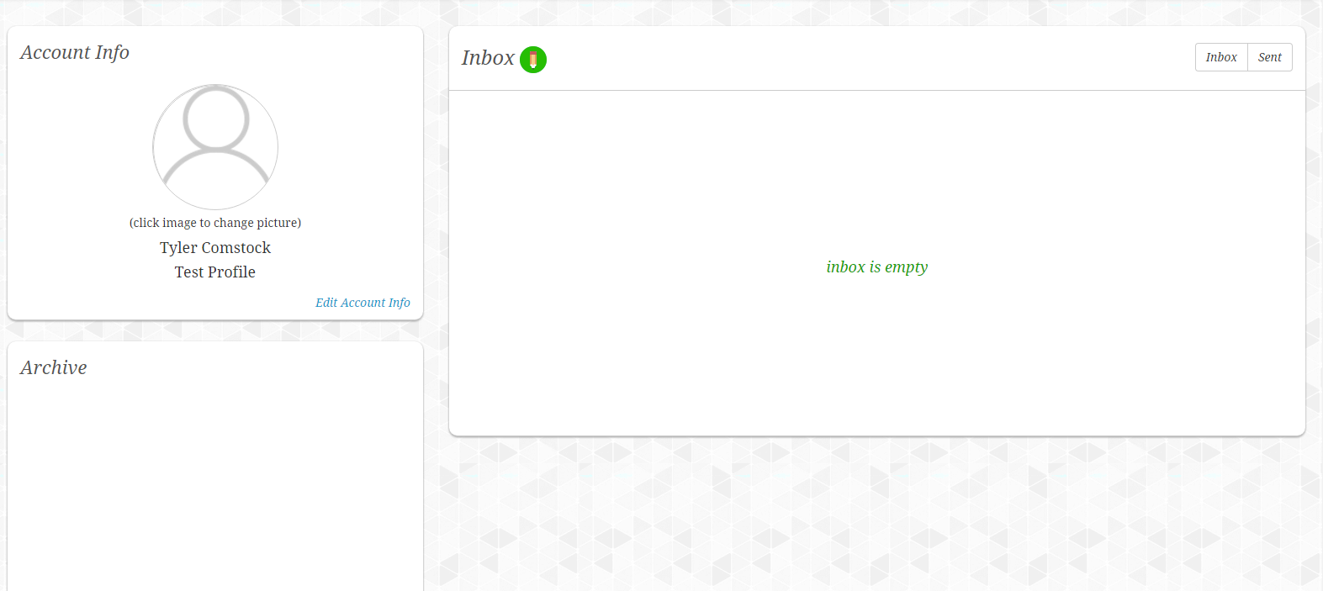

Settings Page
The account info box can be user to change your profile picture or update any information regarding your account.
The archive box will show any lessons that have been “deleted” and will allow you to unarchive the lesson.
The inbox displays and message that have been sent or received.
Click the to compose a new message.

Slide 13
Admin Rights
If your user is set up as an admin you will have the right to view/edit/comment on any teachers lesson.
The admin page displays all the teachers in your district.
Click a teachers name to view their lessons.
Click their lesson to load it for viewing.
Admins also have a “dropbox”. Whenever a teacher submits a lesson for review the lesson will appear in this “dropbox”.
Once again click the lesson to view it.

Slide 14
Contact Info
The contact link loads a modal with my contact information. Fill out the form and submit a email if you have any further questions.
Name: Tyler Comstock
Work Number: (607)7390-3581 ext. 1564
Email Address: tcomstock@gstboces.org

